Slide 1
GEARWAVE (Defect Analysis)
By - Nitin Vishwakarma

Slide 2
Scenario
Welcome to the Gearwave an imaginary bike parts manufacturing! I work for a fictional company, Gearwave, along with some key team members.
I work as a junior data analyst supporting the production and manufacturing teams to understand defect patterns and identify opportunities for quality improvement.

Slide 3
Questions Asked
The production and manufacturing teams raised eight key questions:-
How has the defect trend changed over time?
Which defect types contribute the most to overall defects?
Which defect types are the most expensive to fix?
How does defect severity impact repair cost?
Which inspection method detects the most critical defects?
Are certain defect locations associated with higher severity?
Do certain inspection methods lead to lower repair costs?
Which products generate the highest number of defects?

Slide 4
About data
The analysis uses data from the past six months, consisting of 1,000 records across 10 columns.–
  defect_id: Unique identifier for each defect.
  product_id: Identifier for the product associated with the defect.
  defect_type: Type or category of the defect (e.g., cosmetic, functional, structural).
  defect_description: Description of the defect.
  defect_date: Date when the defect was detected.
  defect_location: Location within the product where the defect was found (e.g., surface, component).
  severity: Severity level of the defect (e.g., minor, moderate, critical).
  inspection_method: Method used to detect the defect (e.g., visual inspection, automated testing).
  repair_action: Action taken to repair or address the defect.
  repair_cost: Cost incurred to repair the defect .

Slide 5
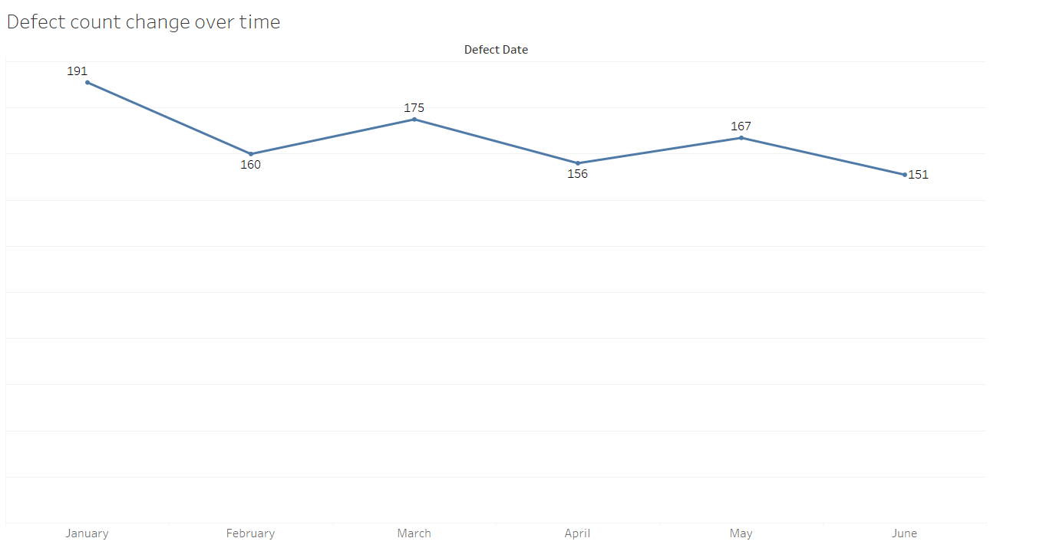
How has the defect trend changed over time?
The defect trend shows a clear overall decline of around 21% over six months. However, the month-over-month fluctuations indicate that quality improvements are not yet fully stabilized and may require sustained process control.

Slide 6
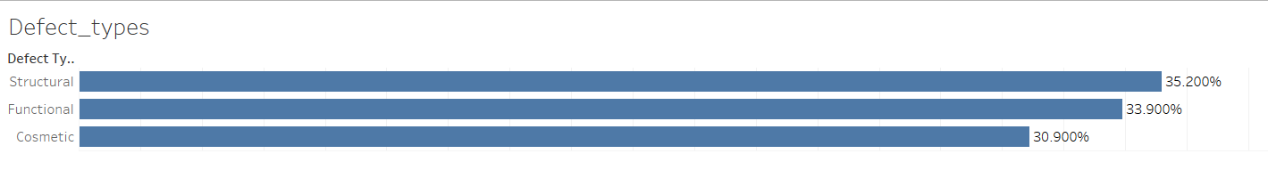
Which defect types contribute the most to overall defects?
Structural defects are the highest contributor at 35.2%, followed closely by functional defects at 33.9%, indicating that core product integrity issues are the primary quality concern.
Although structural defects are the largest category, the relatively even distribution suggests quality issues span multiple areas rather than a single isolated problem.

Slide 7
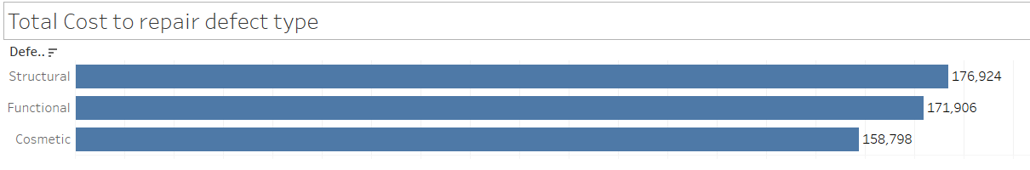
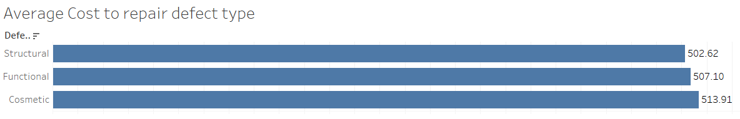
Which defect types are the most expensive to fix?
Although structural defects contribute the highest total repair cost due to higher volume, cosmetic defects have a higher average repair cost per incident, indicating that individual cosmetic issues may require more intensive rework

Slide 8
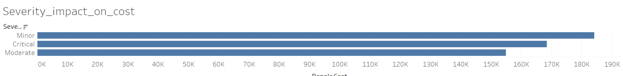
How does defect severity impact repair cost?
Defect severity has a direct impact on repair cost. Although minor defects occur more frequently and may contribute to higher total cost, critical defects have the highest average repair cost per incident, making them high-risk issues that require prioritization.

Slide 9
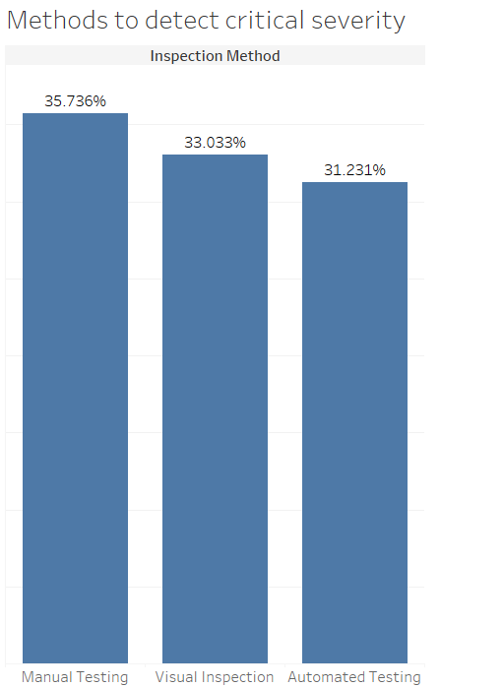

Which inspection method detects the most critical defects?
Manual inspection identifies the highest number of critical defects. However, this is likely influenced by inspection volume.

Slide 10
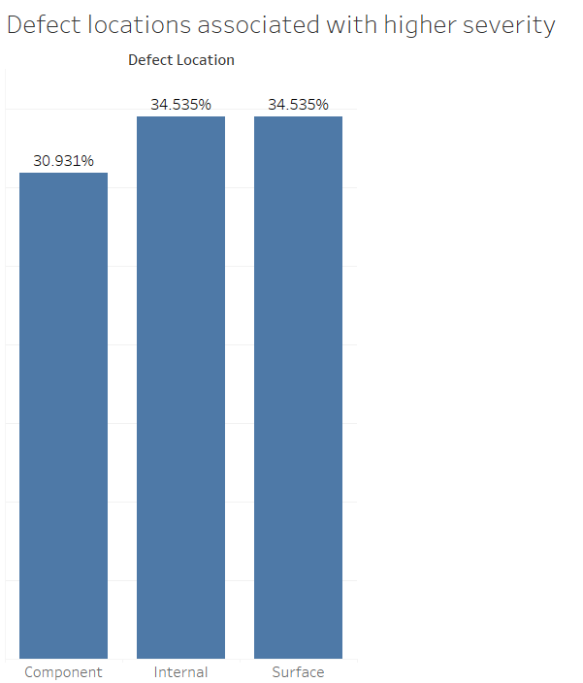
Are certain defect locations associated with higher severity?
Internal and surface defect locations account for a slightly higher share of critical defects compared to component-level issues, indicating increased severity risk in these areas. However, severity risk is distributed across all locations rather than isolated to one.

Slide 11
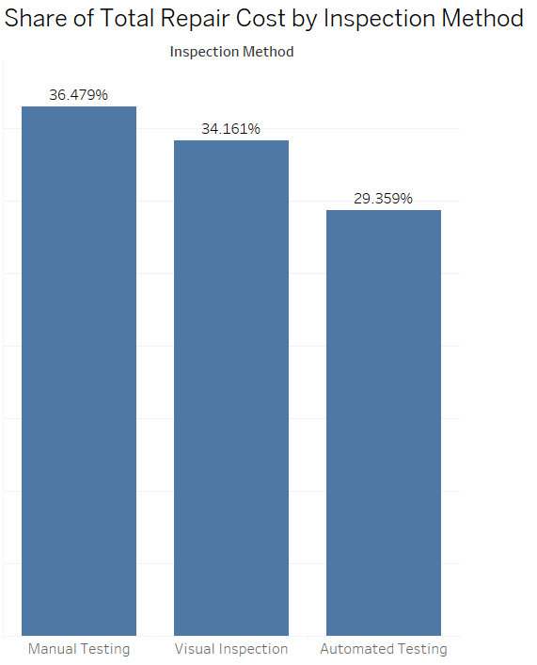
Do certain inspection methods lead to lower repair costs?
Manual testing contributes the highest share of total repair cost at 36.5%, largely due to defect volume. However, automated testing contributes the lowest share and shows lower average repair cost, indicating better cost efficiency through early detection.

Slide 12
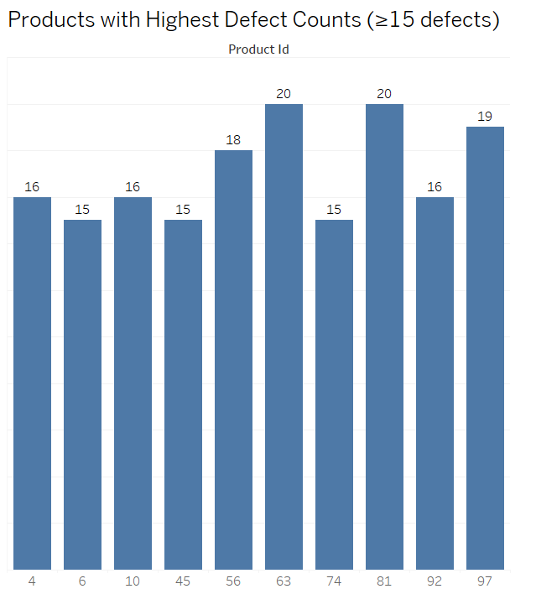
Which products generate the highest number of defects?
A small set of products repeatedly generate high defect volumes. Products 63 and 81 emerge as the most defect-prone, indicating potential design, process, or material issues specific to these SKUs

Slide 13
Conclusion & Key Takeaways
Overall defect volume shows a declining trend over the 6-month period, indicating gradual improvement in quality, though month-to-month fluctuations suggest process stability is not yet consistent.
Structural and functional defects together contribute ~69% of total defects, making them the primary focus areas for quality improvement initiatives.
Structural defects generate the highest total repair cost, driven by higher defect volume, while cosmetic defects have a higher average repair cost per defect, indicating higher rework effort per incident.
Defect severity directly impacts repair cost:
  Minor defects contribute higher total cost due to frequency
  Critical defects have the highest average repair cost, representing higher risk per incident
Manual testing detects the highest number of critical defects, followed closely by visual inspection and automated testing. However, this is likely influenced by inspection volume rather than detection efficiency alone.
Automated testing shows lower average repair cost and lower share of total repair cost, suggesting earlier defect detection and better cost efficiency.
A small set of products (notably Product 63 and 81) consistently show higher defect counts, indicating recurring quality issues that require targeted root-cause analysis.
Internal and surface defect locations are slightly more associated with critical defects, though severity risk is spread across all locations.

Slide 14
Management Recommendations
Prioritize structural and functional defect reduction to control overall defect volume and cost.
Use automated testing earlier in the process to reduce downstream repair cost.
Conduct focused root-cause analysis on high-defect products and high-severity locations.
Combine manual, visual, and automated inspections to balance coverage and cost efficiency

